Slide 1





FINC3600 Project 1 WOW
– CC Workshop 4 - Team 2
Pinzhang(Jack) Cheng
SID: 500260425
Zige(Ziggy)
Liang
SID: 490587854
Hassan
Ahmed
SID: 500482658
Xiaoyu(Zoe)
Yan
SID:490590186
Ruohan(David)
Liu
SID:500191347
Notes:
Good morning, we are team 2 in CC Workshop 4. Our presentation will cover the key recommendations on scope of operation for Woolworths based on our main research result.

Slide 2
Key Recommendations
We suggest Woolworths to enter the pharmaceutical industry to capture more growth opportunities by acquiring 100% of the shares in Sigma Healthcare (SIG.AX) via a scheme of arrangement.
SIG | SIG.AX | IDX.AX
Market Cap ($m) | 677.94 | 745.85
Price to Book Value | 1.39 | 2.79
EV to EBITDA | 42.55 | 32.52
EV to Sales | 0.27 | 2.88
The integration will also make further capital expenditure in data and technology an attractive growth opportunity to boost the performance of both of their rapidly growing online business.
Notes:
Our key recommendation is for Woolworths to enter the pharmaceutical industry to capture more growth opportunities and unleash the potential of its leading retail ecosystem. Our strategic expansion can be achieved by acquiring 100% shares of Sigma Healthcare via a scheme arrangement. Sigma is a leading Australian full line wholesale and distribution business to community and pharmacy. Another potential acquisition target we identified is IDX, Integral diagnostics. It is a leading provider of medical imaging services. Based on our screening, we reckon SIG is a more valuable acquisition target and will have a better synergy with Woolworths than IDX. With acquisition of SIG, further investment in data and technology is an increasingly attractive growth opportunity to boost the performance of both WOW and SIG’s rapidly growing online business.

Slide 3
WOW has a strong synergy with SIG, the acquisition is expected to benefit both firms significantly as they adjust and evolve in response to Covid-19.
WOW has evolved a mature food and everyday needs ecosystem. Incorporating SIG extends its ecosystem into provision of health and wellness services. It can help boost customer loyalty further.
WOW’s service capabilities in eCommerce, retail media, data and analytic, and logistic network can help further strengthen SIG’s existing business model.
10 years experience in logistics industry can effectively alleviate delivering pressure of WOW’s due to the increasing demand eCommerce purchase.
The distribution centres owned by SIG are located in the main cities that have the highest density of Woolworths stores, which enable the group to provide a more flexible delivery service.
Notes:
Not only can the acquisition benefit WOW alone, but the strong synergies between WOW and SIG \ can also significantly enhance the performance of SIG’s existing operational performance / as they adjust and grow in response to Covid-19.
To start with, WOW has evolved into a mature food and everyday needs ecosystem. Incorporating SIG extends its ecosystem into the provision of health and wellness services. It can help boost customer loyalty further.
Secondly, WOW's service capabilities in eCommerce, retail media, data and analytics, and logistic networks can help further strengthen SIG's existing business model.
Apart from that, ten years of experience in the logistics industry can effectively alleviate the pressure of WOWs due to the increasing demand for eCommerce purchases.
Lastly, the distribution centres owned by SIG are located in the main cities with the highest density of Woolworths stores, which enables the group to provide a more flexible delivery service.

Slide 4

ESG Impact of SIG Acquisition
ESG Risks of SIG:
Sigma are not exposed to high levels of material ESG risks
SIG have had OH&S incidents
Are still in the process of identifying climate and other risks and tackling potential improvements in such areas
No material financial impact
WOW can help alleviate any ESG risks with the help of their organisation
Social Impact: Growth opportunities allow WOW to provide pharmacies and medicines accessible to more Australians.
SIG enhances Woolworth’s brand and mission (similar to the Endeavour demerger).
Notes:
One main benefit of the acquisition will be that it would reinforce Woolworth’s position of pursuing its purpose, which is “to create better experiences together for a better future tomorrow”. The acquisition of Sigma Healthcare Ltd will help WOW Group in that regard, as they will be aiding Australians to have greater access to pharmaceutical needs at a competitive price. We think that it will contribute to enhancing Woolworth’s brand even more, similar to the way the demerger of Endeavour Group did. This will happen as it will represent a significant shift in Woolworths operations (from disassociating with acitivities that are harmful to the public with involvements in gambling and alcoholic beverages, to more positively associated services of providing essential medicines to people around the country. As such, this will potentially reinforce positive brand affirmation amongst the public.
We also do not see any significant ESG risks that Woolworths may inherit from the acquisition of Sigma, that would have a material and immediate financial impact for the group. This is because Sigma have only had minor incidents thus far, such as those involving operational, health and safety breaches of their workers, steps for which Sigma have already acted upon. Apart from that, Sigma Healthcare are still attempting to develop a robust framework to address climate related issues, which can be aided by the acquisition, as Woolworth’s governance structure which has thus far established a thorough policy to address ESG risks for the Group, can also incorporate Sigma’s potential shortcomings.

Slide 5
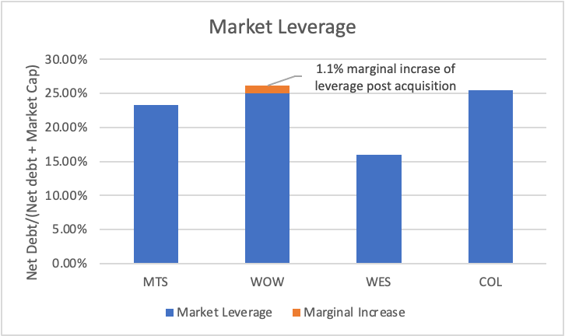
Scheme Arrangement and Associated cost
We suggest an issuance of $750 million long-term secured loan with a 6.5% fixed interest rate and 10-year maturity to facilitate the execution of our recommendations. Additional expenditures will be financed by WOW’s existing liquidity.
We recommend an offer of $0.85 per SIG share, representing a 32.8% control premium to SIG’s closing share price at 1 AUG 2022 of $ 0.64.
The integration cost of acquiring SIG’s business is estimated to be around A$35 million.
Notes:
We suggest WOW to source $750 million long-term secured loan with a 6.5% fixed interest rate to support the implementation of our recommendations. Any additional expenditure can be financed by existing liquidity of WOW. We quote an offer of $0.85 per share of SIG, which representing a 32.8% control premium to SIG’s closing share price $0.64 at first of August. By assessing the integration cost of acquisition of API by Wesfarmers, we expect a similar associated cost of acquiring SIG at approximately 35 million dollars. The acquisition is estimated to increase Woolworths’ leverage by 1.1% overall.

Slide 6
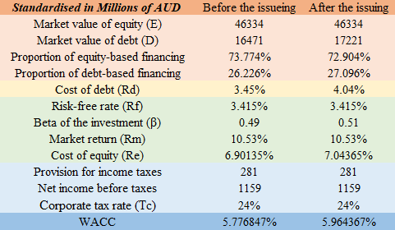
The impact of long-term loan borrowing on WACC
The issuance of a $750m long-term loan will increase Woolworth's WACC from 5.78% to 5.96%.
A higher WACC typically signals a higher risk associated with a firm's operations. The company's valuation may decrease because it uses more debt and equity financing to operate.
Although a higher WACC may seem a cause for concern, it isn’t necessarily a negative mark since the company is issuing corporate bonds to fuel corporate expansion.
Notes:
Following Woolworths' issuance of 750 million Dollars of long-term debt, the company's WACC will increase from 5.78% to 5.96%.
A higher WACC typically signals higher risk associated with a company's operations, as the company pays more for the capital investors put into the company. Generally, as the risk of investment increases, investors demand additional returns to neutralize the risk. In addition, an increased WACC indicates that a company's valuation may fall as it uses more debt and equity financing to operate.
However, while a higher WACC may seem to be concerned, it is not necessarily a negative sign as companies are issuing loans to drive corporate expansion and seek better growth in the future. Companies should provide insights in their regular reports as to why the company is taking on debt, which will help to stabilize the investors’ confidence.

Slide 7
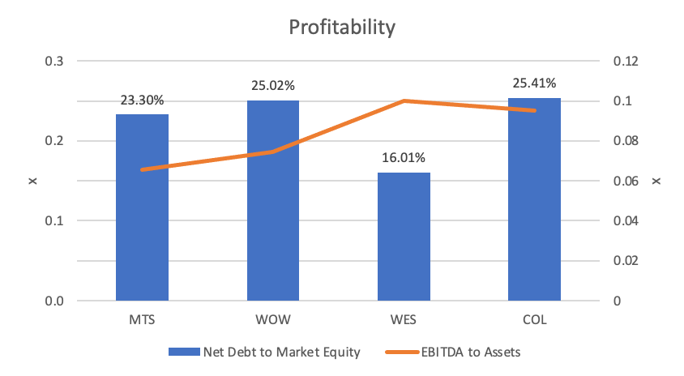
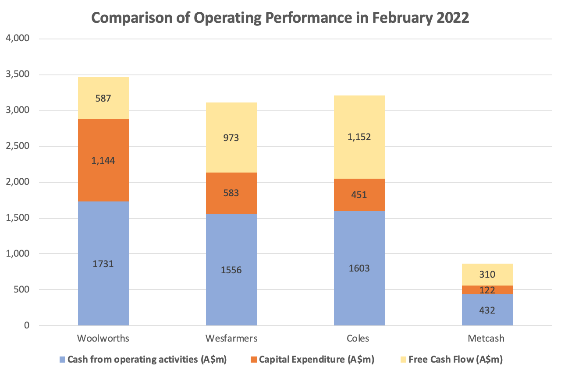
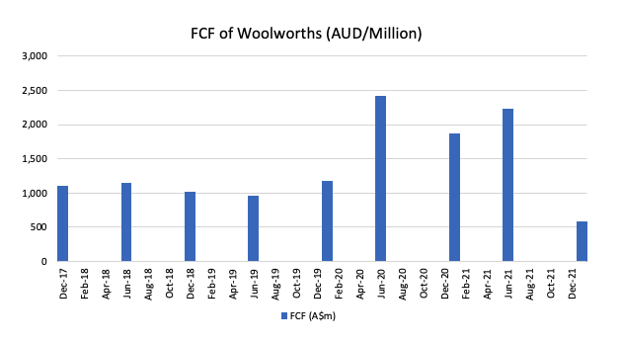
Due to severe disruption of Covid-19 on its business operations. WOW currently has a relatively low profitability and limited FCF compared with its peers. Moreover, FCF in the early 2022 has plummeted below its pre-pandemic level, reflecting its need of external financing.
‹#›
Notes:
Due to disruption of Covid-19 on its business operations, WOW has a relatively less satisfactory performance in terms of profitability compared with its peers. Moreover, the weak operating performance is also reflected by its low FCF of 587 million in early 2022, and it is not only lower than its key competitors such as COL and WES, but also lower than its pre-pandemic level. So, the debt financing can also help the company stabilise the liquidity to cover any potential costs.

Slide 8
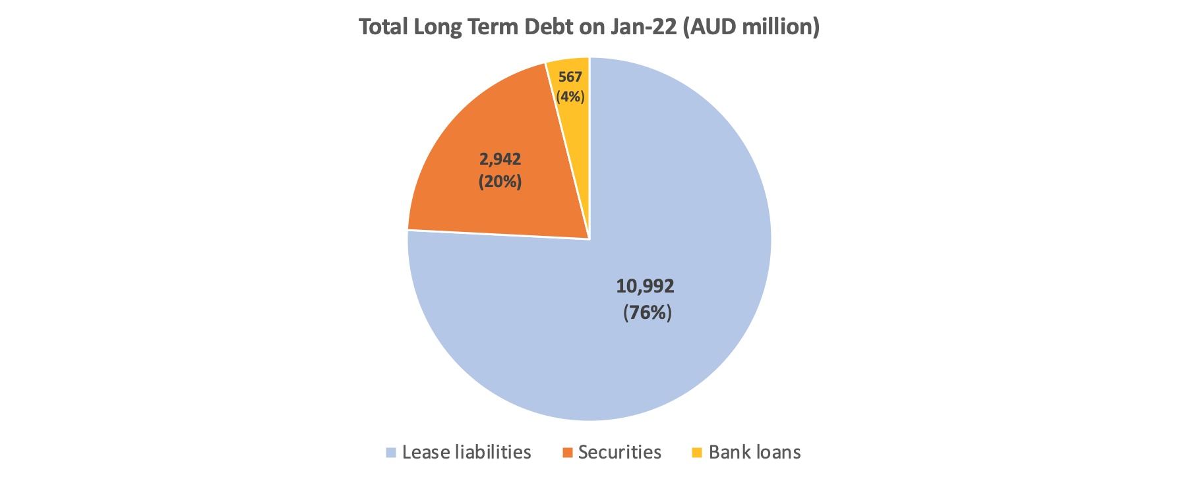
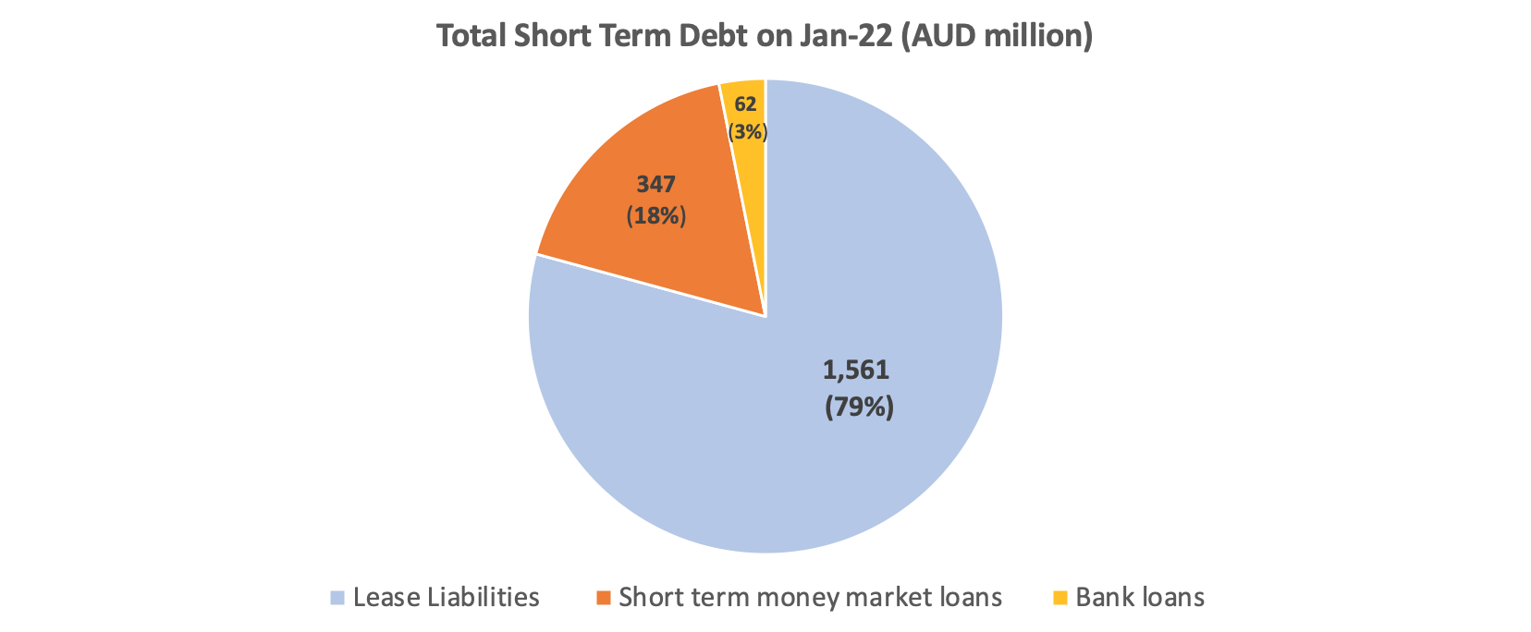
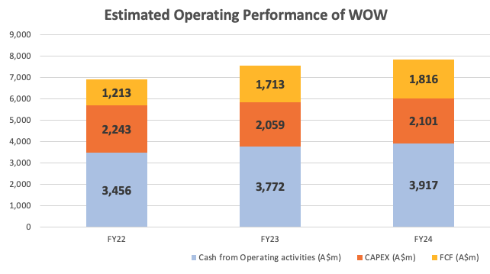
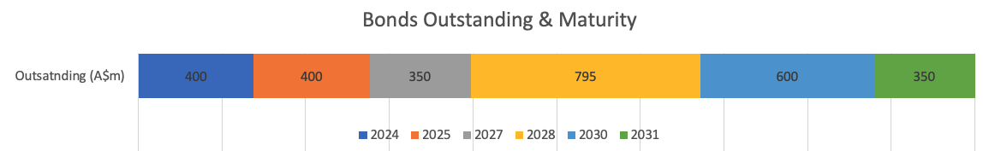
Woolworths has six bonds that will mature in the next 10 years and each maturity has a very close gap. The revenue of Woolworths is expected to increase because the market is warming up after the Covid-19 pandemic. The FCF of Woolworths was originally expected to rise by 41% and 51% in 2023 and 2024 respectively compared with the estimated free cash flow by the end of 2022. After acquisition of SIG, it is expected that its FCF performance will increase further.
Notes:
Another reason we choose to issue a long-term loan is that WOW currently has accumulated lots of bonds that each will mature closely in the next 10 years. And, WOW has a higher default rate compared with its competitors, and it is reflected by the CDS premium, so the investors are likely to expect more risk premium if the WOW chooses to issue bonds. Besides, the left-hand side pie chart shows that WOW has a lower weight of loan borrowing compared with bonds. So, a loan with fixed interest and interval repayments can reduce the pressure of adding another huge one-off payback in the future. The FCF of WOW in the next 2 years is estimated to increase by 41% and 51% respectively, which implies that it is more appropriate for WOW to issue a long-term loan because the bounce of profit enables the group to afford the interval loan payments in the future. So, we expect WOW’s FCF to increase further after the acquisition of SIG.

Slide 9
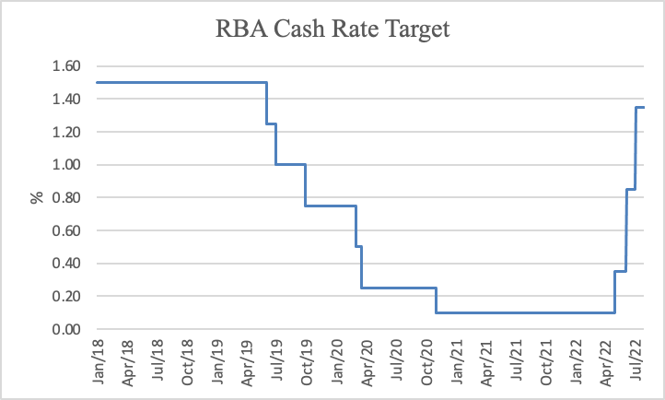
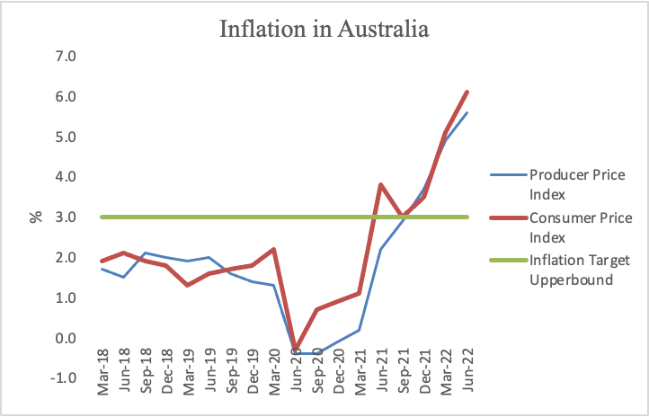
With awareness of the surging inflation felt by Australia, It is expected that RBA will keep increasing cash rate to help bring back inflation to the targeted 2% - 3%. As a result, we reckon the 750 million long-term debt issuance is urgently needed to prevent further increase in borrowing cost.
Notes:
We are also aware of the surging high inflation in the market. We can see that the current cash rate target has yet to reach its pre-pandemic level. It is expected that RBA will increase cash rate further to absorb the excess inflation. As a result, we reckon the debt issuance is urgently needed to prevent potential increase in borrowing cost.

Slide 10
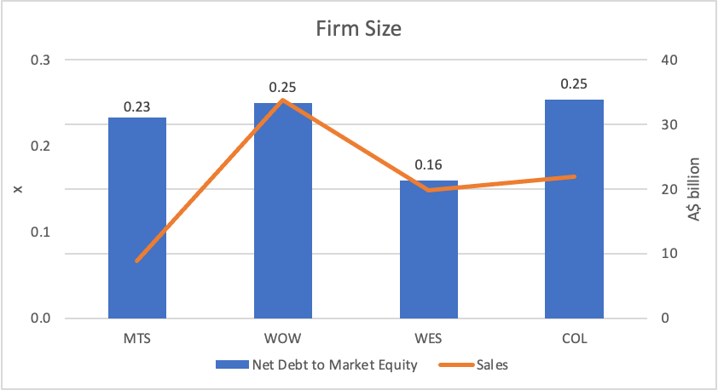
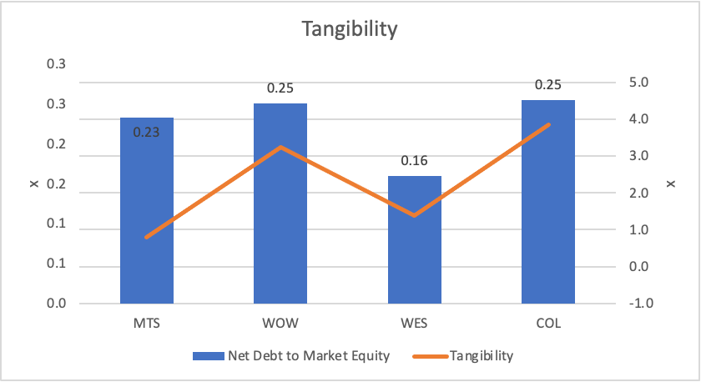
In comparison with its peers, being the largest firm and having the second highest tangibility of assets allow Woolworths to marginally raise their leverage without significant concern over material cost incurred by additional financial distress.
Notes:
Compared with its peers, Woolworths has a relatively high leverage. Nevertheless, being the largest firm among its peers in terms of sales and having a high tangibility of its assets allow WOW to operate efficiently after the marginal increase in their leverage without significant concern over the material impact of associated increase in financial distress.

Slide 11
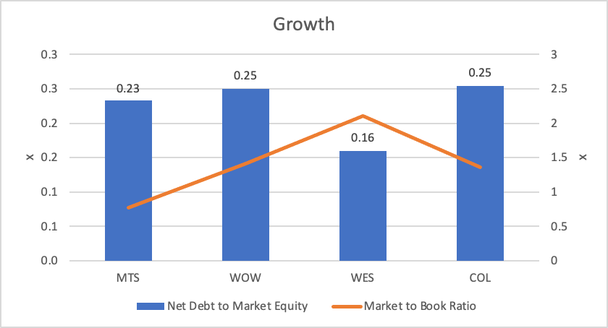
After realisation of the synergy with SIG, WOW’s profitability will be boosted significantly. To align its capital structure with this strategic extension, WOW is recommended to gradually lower its leverage to reserve enough financial flexibility as a comparative advantage to capture emerging growth opportunities in the pharmaceutical industry.
Notes:
As noted before, we expect a further boost of profitability after acquisition of SIG. We can see that WES has a noticeably lower leverage and faces more growth opportunities. By entering pharmaceutical industry and being a competitor to WES, it is also recommended that WOW should gradually decrease its debt level to reserve sufficient financial flexibility as a comparative advantage for its better growth in the pharmaceutical industry.

Slide 12
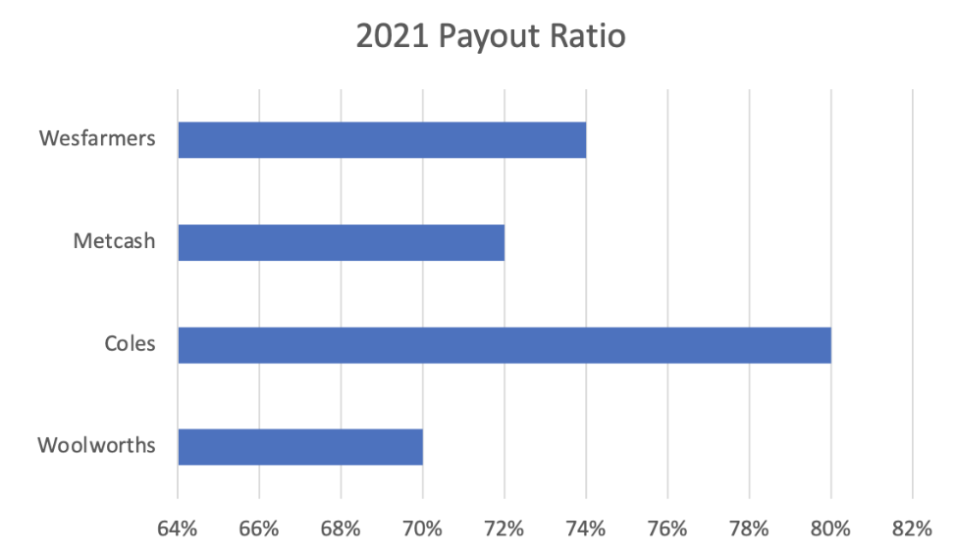
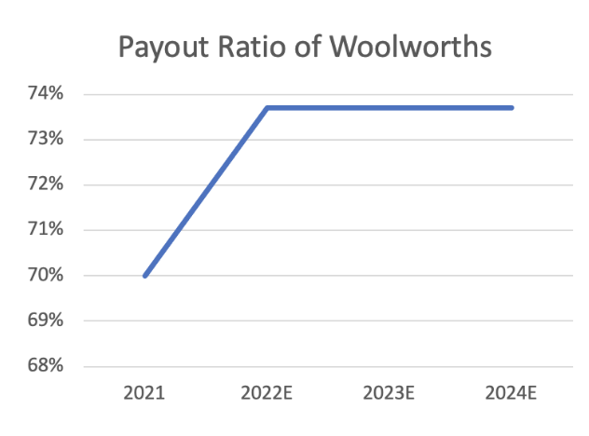
-The payout ratio of Woolworths is around 70%, which is slightly lower than its competitors (Coles: 80%, Metcash: 72%, Wesfarmers: 74%).
-According to the 2022 Broker's Report, Woolworths' net profit is expected to grow from 2023, and the dividend payout ratio is predicted to stabilize at 73.7% in 2022-2024.
-The acquisition of SIG can boost it profitability, which allows WWS to pay around 4% more dividend to its shareholders.
Notes:
After the acquisition of SIG and the issuance of debt, Woolworths is advised to increase its payout ratio. Woolworths has a relatively low payout ratio of around 70% compared to peers Coles, Metcash and Wesfarmers. According to the 2022 Broker report, Woolworths' net profit will start to grow from 2023, and the dividend payout ratio is expected to stabilize at 73.7% in 2022-2024. After an increase of profitability with acquisition of SIG, Woolworths has the ability to increase its dividend payout ratio by around 4%. And all dividends paid by the company are franked to 100% at the 30% corporate income tax rate. An increase in the dividend would increase shareholder confidence in the company's future plans, while also sending a clear and strong message to the outside world about Woolworths' strong financial performance.

Slide 13
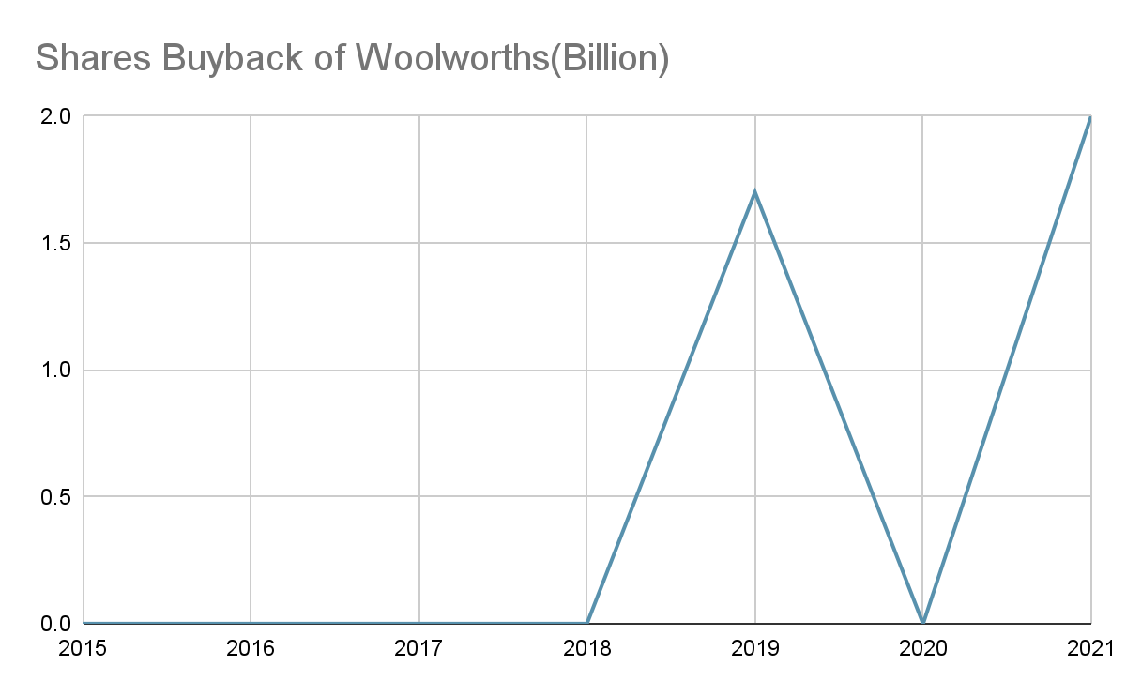
Following the SIG acquisition, Woolworths is not advised to buy back its shares in the short term, as it just completed a $2 billion off-market share buyback a year ago, and it has only two buybacks in its history.
Notes:
Additionally, we do not recommend Woolworths repurchasing shares in the short-term, as it just completed a $2 billion off-market share buyback a year ago, and it has only two buybacks in its history. Instead of repurchasing shares, wws can use residual earnings for other investments.

Slide 14
Thank you
Notes:
That concludes our project report. Thank you for your time.

Slide 15
Q&A
Notes:
We are now happy to answer any questions.

Slide 16
Appendix

Slide 17
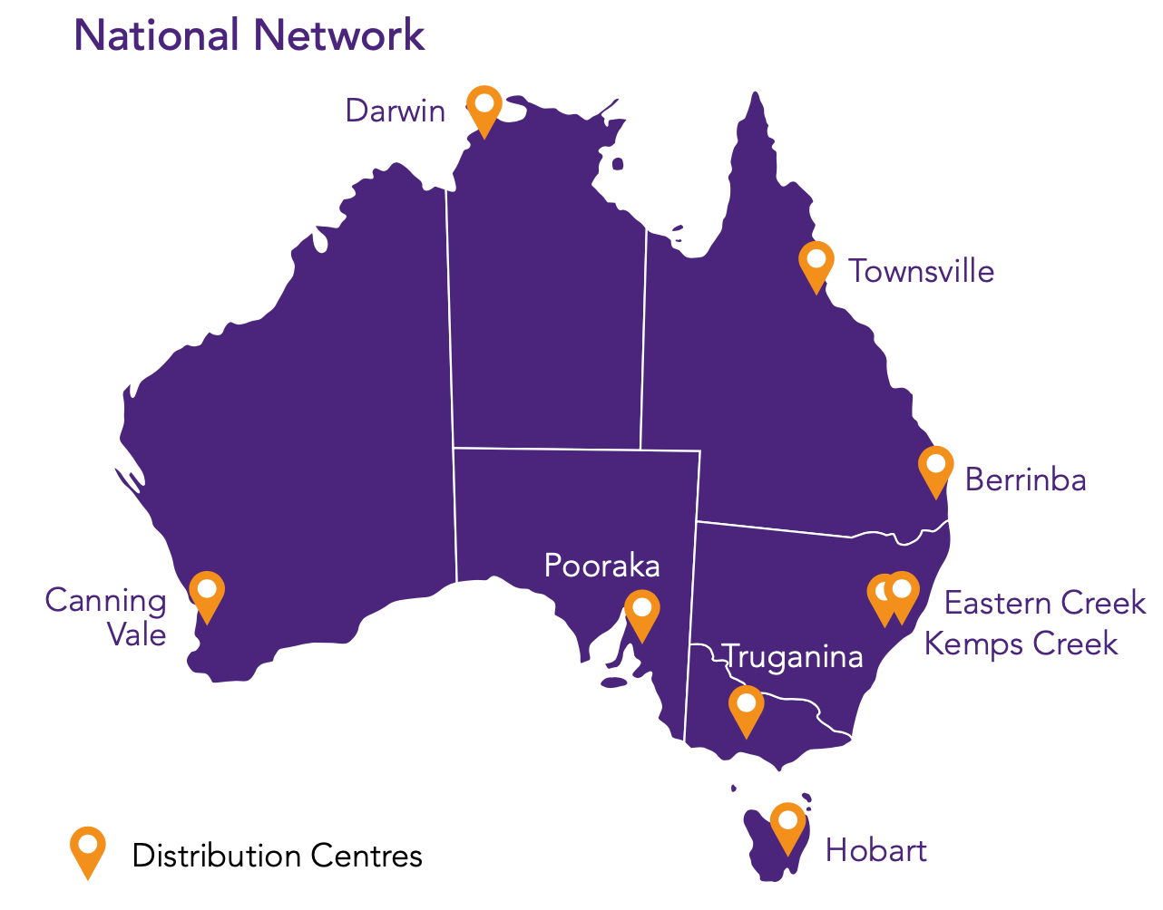
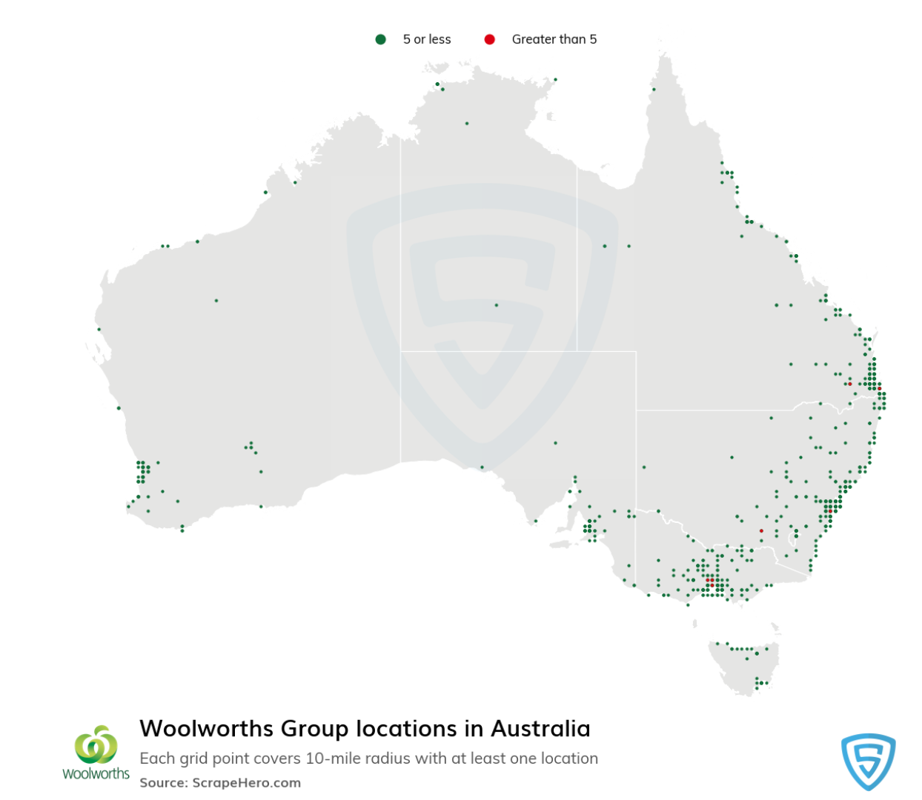
The map distribution centres of SIG in Australia
The Map Distribution Woolworths Stores in Australia

Slide 18
Sources and references to WACC formula inputs
Capital Structure
We use the firm's market cap as the value of E and total debt as the value of D.
Cost of Debt
We use the bond discount rate to estimate the cost of debt. We find the discount rates for the company's outstanding bonds and calculate their weighted average based on each amount issued. For non-Australian dollar bonds, we converted the currency into AUD using the exchange rate of 1 August 2022 before calculation. For the newly published loan, we use the interest rate to estimate the cost of debt.
Cost of Equity
Practitioners will apply a normalized risk-free rate in determining the cost of capital if prevailing market interest rates are low. However, there are many debates about normalization. Some scholars argue that normalization is used to adjust one-time and non-recurring items, so normalizing long-term bond rates are not reasonable when developing discount rates using the CAPM. Therefore, we still apply the Australian Government Bonds rate as the risk-free rate, whose most appropriate maturity is ten years.
As expected returns are usually unobservable, the standard approach to estimating MRP is to average realized (ex-post) returns over a long period. We use the average return of the S&P/ASX 200 Index over the last ten years to estimate market returns as ten years is an acceptable and frequently used time horizon for companies in practice to calculate market return.
Levered β & Tax rate are from refinitiv.

Slide 19
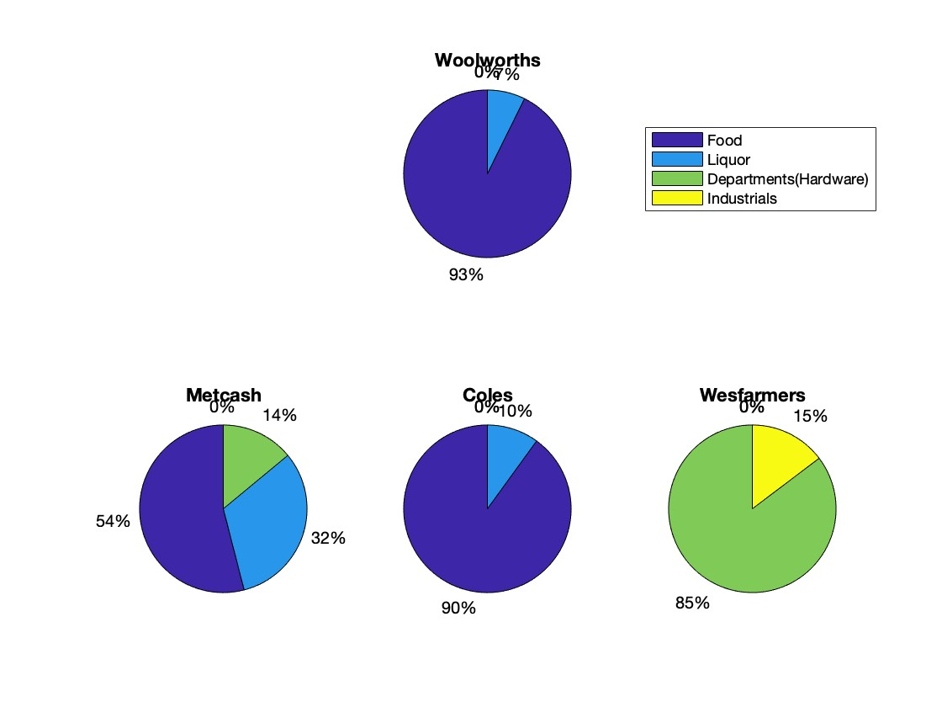
Though Woolworths bears an identical business structure to Coles, sufficient focus should be put on its comparative advantage to Wesfarmers as it expanding its business into the pharmaceutical industry.

Slide 20
From neutrality of capital structure in Modigliani & Miller theorem to mainstream capital structure theories.
Interest Tax Shield and Financial Distress in Tradeoff Theory
Being able to deduct tax payment from paying interest makes debt financing attractive to managers. However, increasing debt level also increases the cost of financial distress. Optimal leverage needs to be considered at the margin of benefit and cost.
Agency Cost and Operation Efficiency in Free Cash Flow Theory
A series of problems can be incurred by the division of ownership and management. If a company is sitting on an excessive amount of free cash flow, managers can be enticed to engage in inefficient activities that do not maximise shareholders’ value. With a higher leverage ratio, the interest payment obligation can help managers make more effective use of resources available.
Friction of External Financing and Financial Flexibility in Pecking Order Theory
Internally generated cash is the most liquid funds to finance business activities. External financing can experience great friction especially when financial market is suffering a downturn. While less prefered, debt financing is still the second best choice since it does not incur material asymmetric information problem as equity issuing.

Slide 21
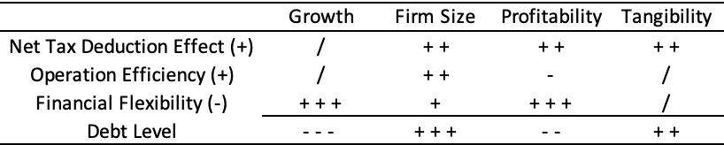
A qualitative analysis framework is developed with incorporation of the theories, linking the key interests (Column 1) with variables of firms (Row 1) that are either directly observable or can be approximated indirectly.
Ratings: / is assigned for relations that are negligible or lacking evidence from literature; + (-) is assigned for correlation that can be explained by theories but is dominated by other associated impacts; + + (- -) is assigned for correlation that is supported by theories and evidence but with limited impact; + + + (- - -) is assigned for correlation that is strongly supported by theories and evidence with no objections from other theories or concerns.

Slide 22
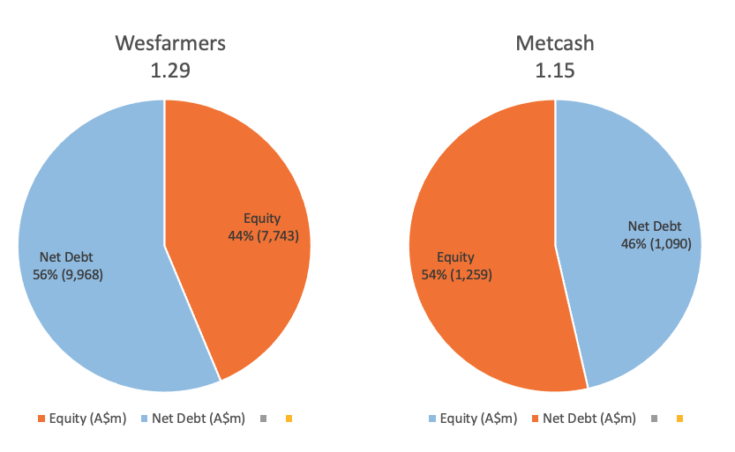
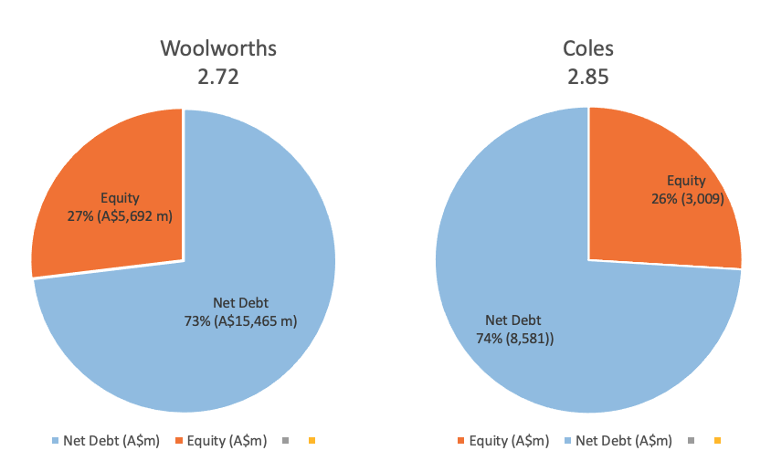
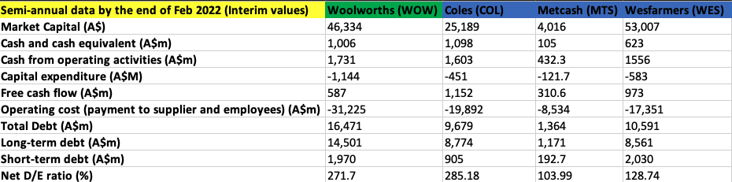

Slide 23
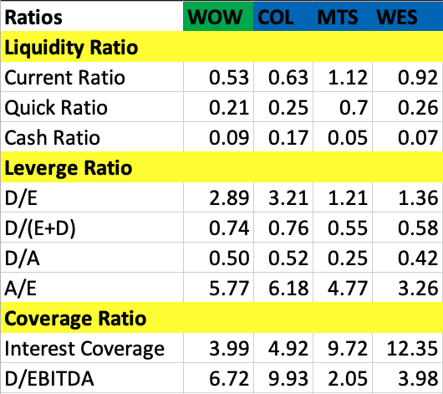
Default Rate & CDS Premium Comparison
Ratios
Company | Probability of Default | Credit Rating | CDS Premium (USD)
Woolworths | 0.09% | BBB / Baa2 | 85
Metcash | 0.07% | NA | NA
Coles | 0.08% | BBB+ / Baa1 | 72.25
Wesfarmers | 0.06% | A- / A3 | 57

Slide 24
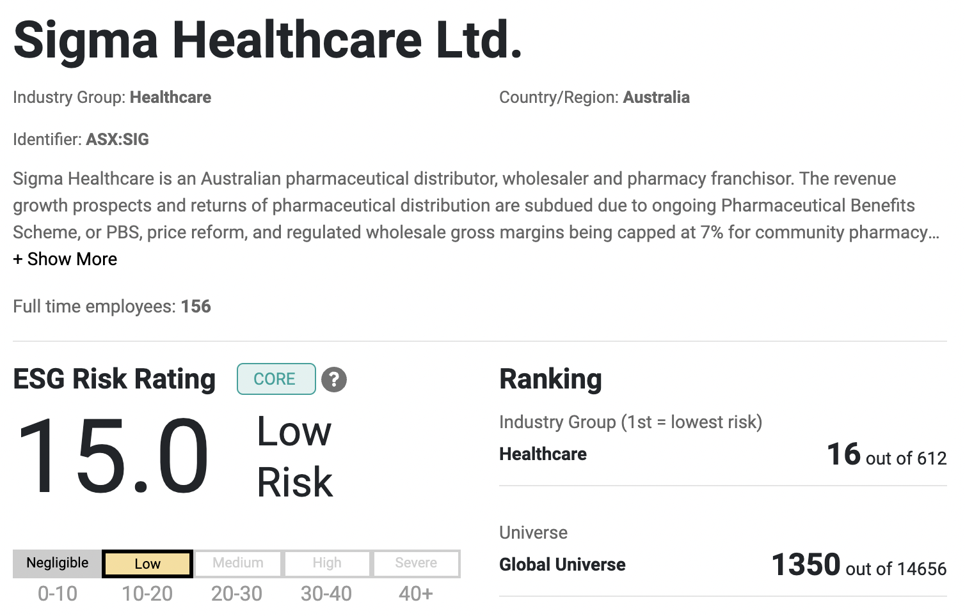
Morningstar Analysis of SIG ESG Risks:

Slide 25
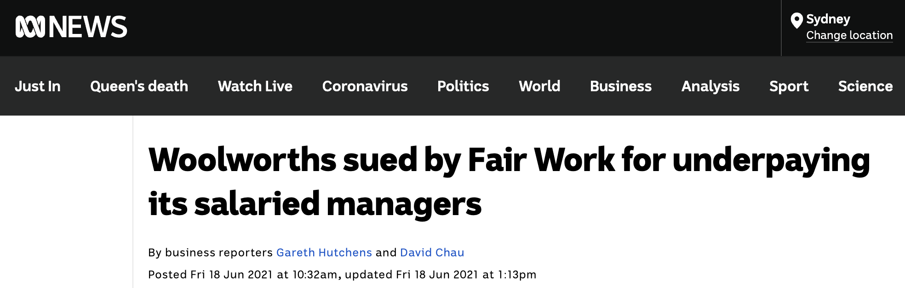
Other ESG considerations
Issue # 1: Underpayment of staff
Substantial news coverage
Wrong disclosures of the underpayment amount in 2019
Incurred in excess of $160m in interest & other remediation charges → represents a meaningful financial impact
Avoidable with extra management training
Issue # 2: Electricity usage of stores
Woolworth’s uses around 1% of Australia’s total electricity
Largest contributor to greenhouse gas emissions
Invest in solar energy for individual stores and make them self-sustainable
Save on electricity, which is the 3rd highest expense, after labour & rent.
Avoid increasing borrowing costs of SLBs (which are performance based)

Slide 26
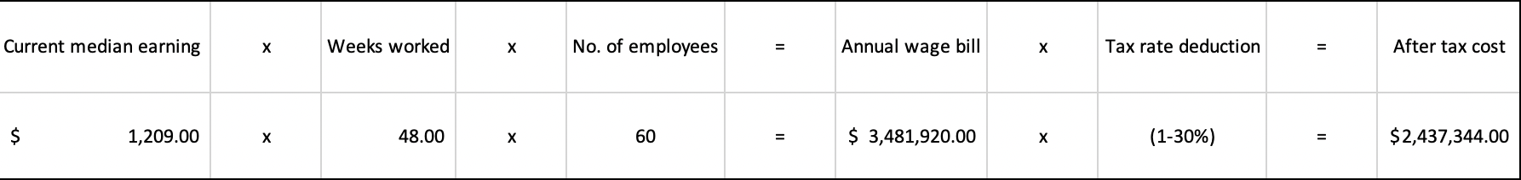
Costs analysis of preventing future underpayments:

